Slide 1

UAE Cancer Patient Data Analysis
CIS 2423 – Programming for Data Analytics
Group 13: Sara Almulla , Aisha Abdulla

Slide 2

Why We Did This
What the Raw Numbers Say
Graphs That Guided Us
Testing Ideas Before Modeling
What We Built and How Good It Is

Slide 3

01
Why We Did This

Slide 4
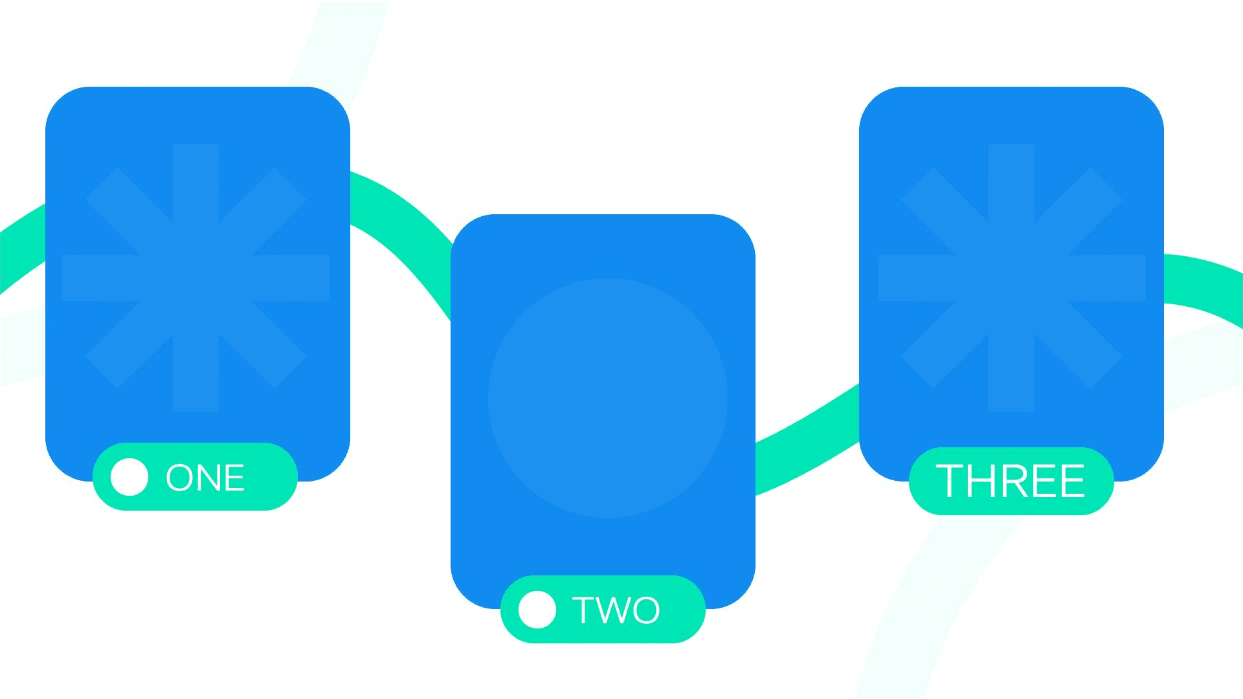
We Wanted to Help Doctors Plan Better
Project Aim
Real-World Impact
We analyzed UAE cancer patient data to help hospitals plan better. Our goal was to understand cancer patterns and predict patient outcomes to support early detection and resource allocation.
By analyzing this data, we can provide insights that help hospitals reserve beds, schedule follow-up visits, and improve public awareness about cancer.
Data Source
We chose this dataset because it is free, clean, and realistic. It has 10,000 patient records with detailed information on demographics, cancer types, stages, and survival data.

Slide 5

Python Environment
Key Libraries
We used Python in Jupyter Notebook because it keeps code, outputs, and explanations in one place, making our work reproducible and easy to understand.
We used pandas for data cleaning, scikit-learn for machine learning, and matplotlib for visualization. These tools helped us build and evaluate our models accurately.
We Chose Python Tools

Slide 6
02
What the Raw Numbers Say

Slide 7

Ten Thousand Patients at a Glance
Dataset Overview
Age Range
Cancer Types
Sampling Validation
The dataset has 10,000 patient records. 9.92% of patients died, with an average survival of 17.5 months among deceased patients.
Patient ages range from 18 to 90 years. The median age is around 50, showing a wide age distribution.
There are ten different cancer types in the dataset. Each type has unique characteristics and survival rates.
We took random and systematic samples of 150 deceased patients. Both samples had similar survival statistics to the full dataset, proving they are representative.

Slide 8
03
Graphs That Guided Us

Slide 9

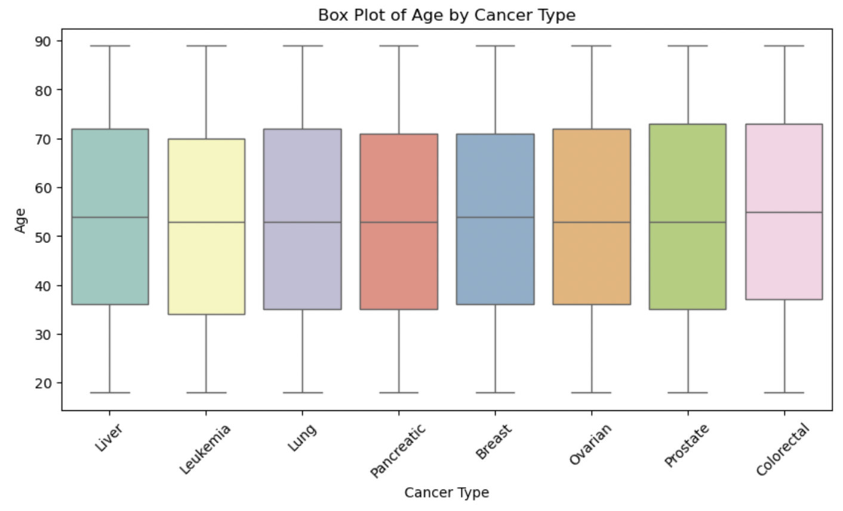
Box Plot Showed Age Gap Between Cancers
Box Plot Insights
The box plot shows the age distribution for each cancer type. It helps us see which cancers affect older or younger patients more, guiding further analysis.

Slide 10
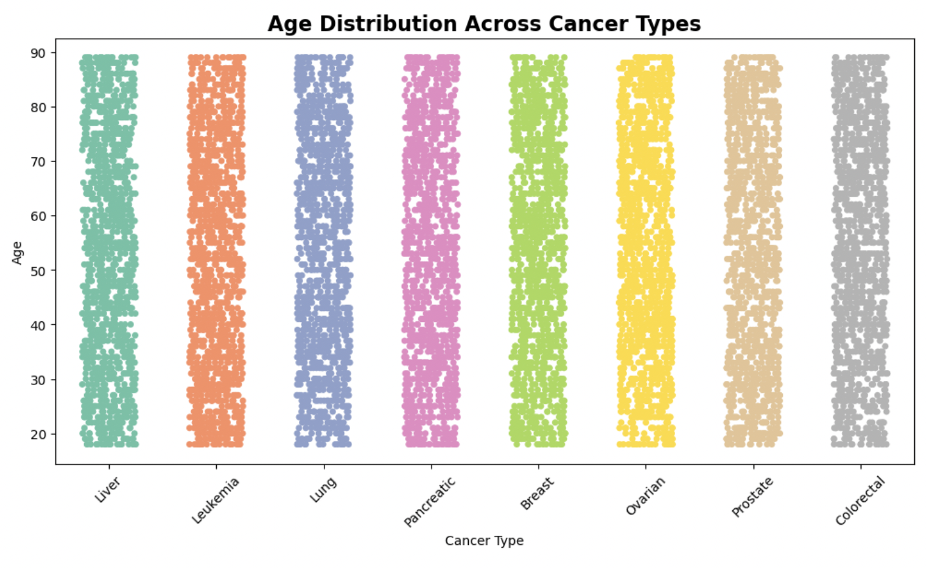
Scatter Dots Proved Age Alone Is Weak
> Scatter plot Insights
The scatter plot shows each patient's age and survival months. It reveals that age alone cannot accurately predict survival, as the data points are widely spread.
>Correlation Analysis
The Pearson correlation coefficient between age and survival months is very low (0.006), confirming that age is not a strong predictor by itself.

Slide 11
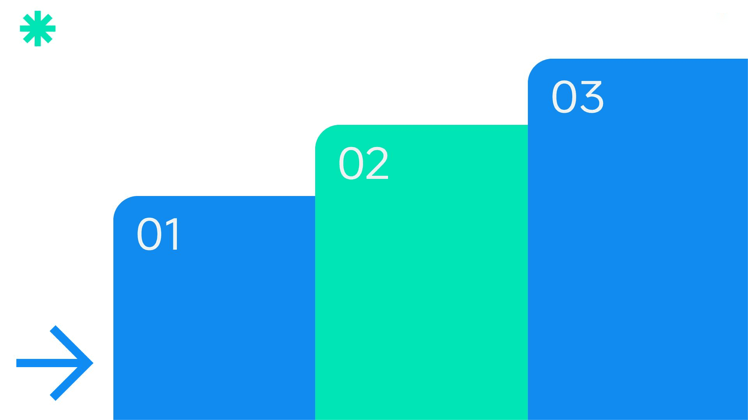
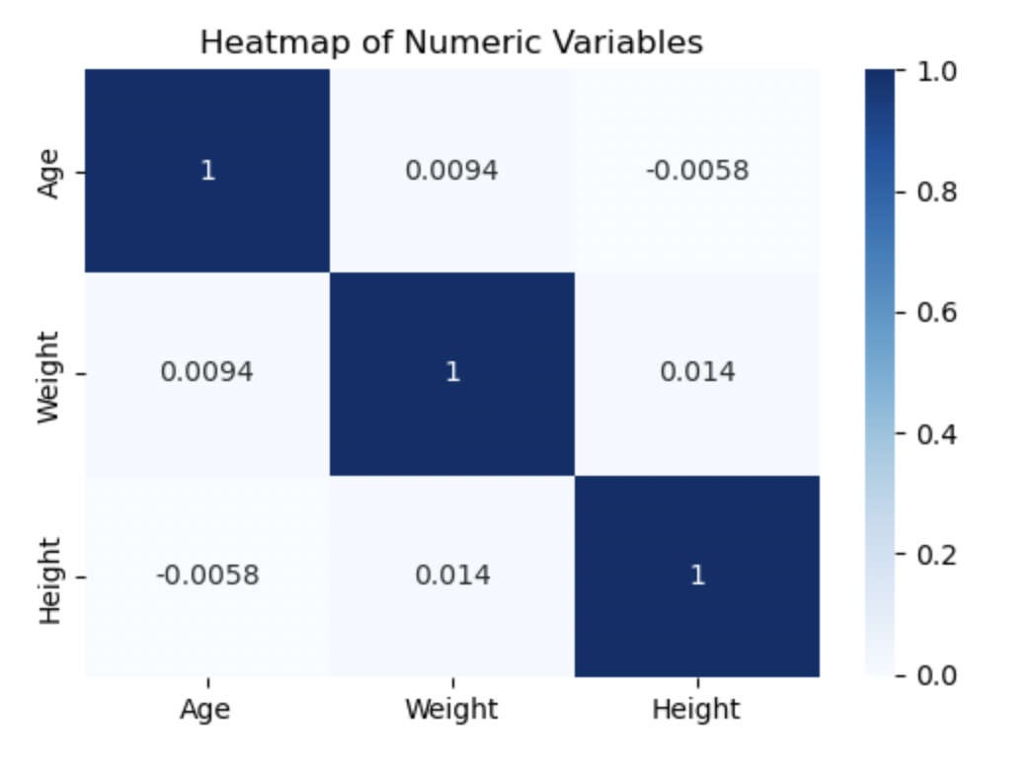
Heat Map Gave Us a First Color Clue
Model Implications
Key Insights
Based on the heat map, we decided to include more variables in our models to improve prediction accuracy.
Heat Map Purpose
The heat map reveals that age has a very weak correlation with survival months. Other variables like stage and treatment type show stronger relationships.
The heat map shows correlations between numeric variables. It helps us identify which variables are related to each other and might be useful in our models.

Slide 12
04
Testing Ideas Before Modeling

Slide 13

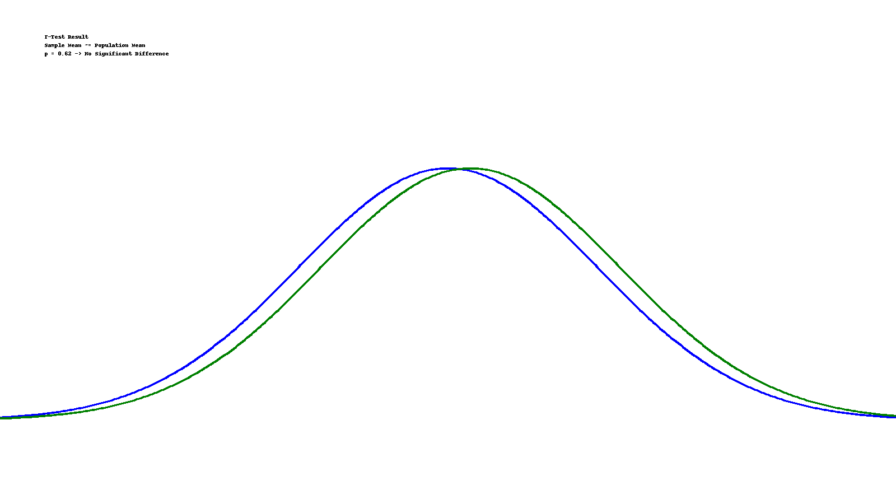
T-Test Results
We performed a one-sample t-test to compare the mean survival months of our sample to the population mean. The p-value was 0.62, indicating that our sample is representative of the population.
T-Test Said Our Sample Matches the Crowd

Slide 14
05
What We Built and How Good It Is

Slide 15
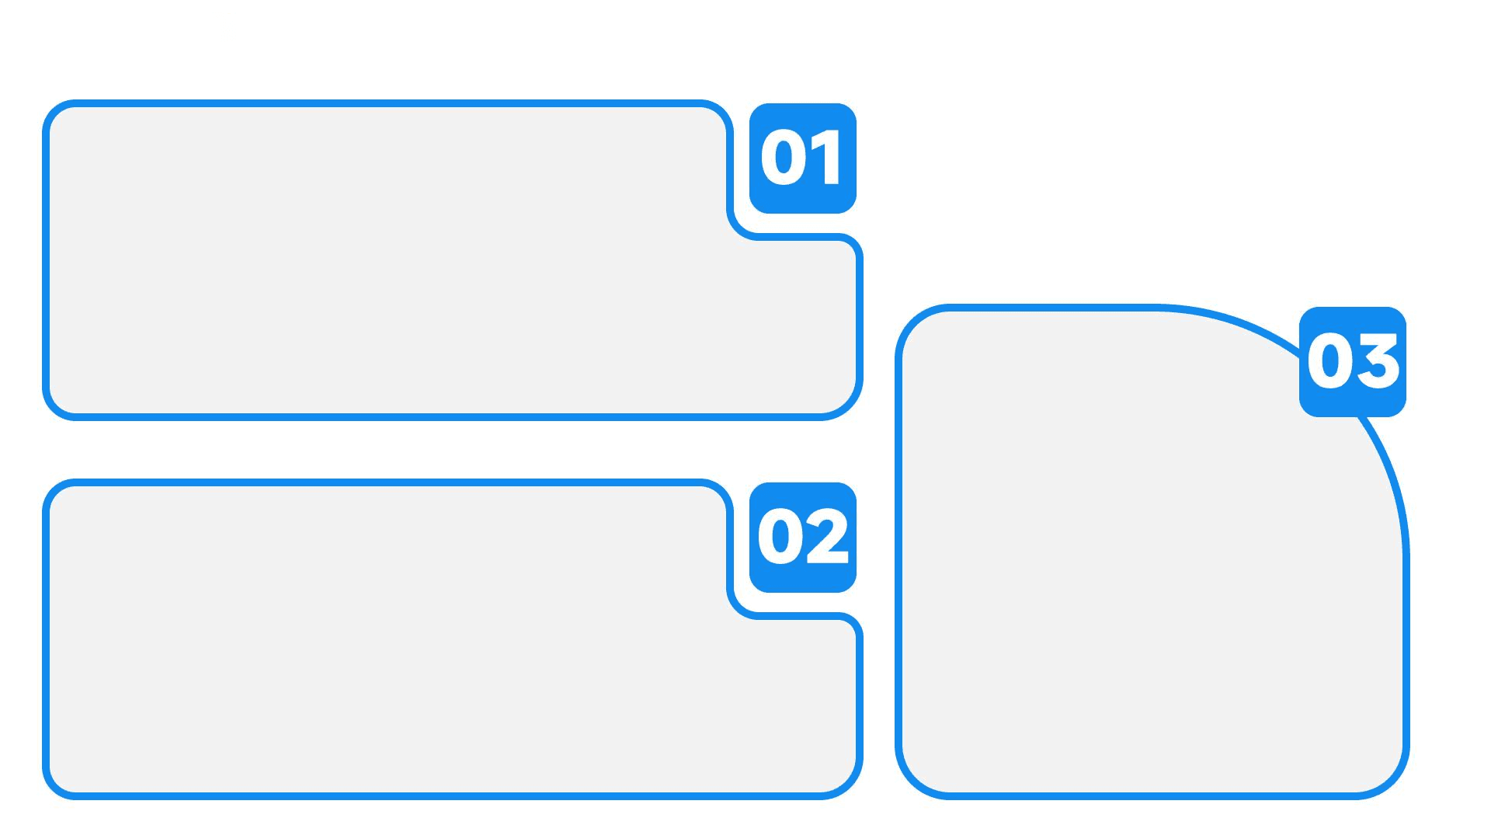
Bar Graph of Accuracy Picked Logistic Regression
Model Comparison
We trained four classification models: logistic regression, KNN, naïve Bayes, and decision tree. Logistic Regression achieved the highest ROC-AUC (0.78), making it the best model for predicting recurrence.
Future Work
Accuracy Insights
We plan to collect more data to further improve the model's accuracy and robustness.
The bar graph clearly shows that logistic regression outperforms the other models. This makes it our best choice for predicting cancer recurrence.

Slide 16


